Slide 1
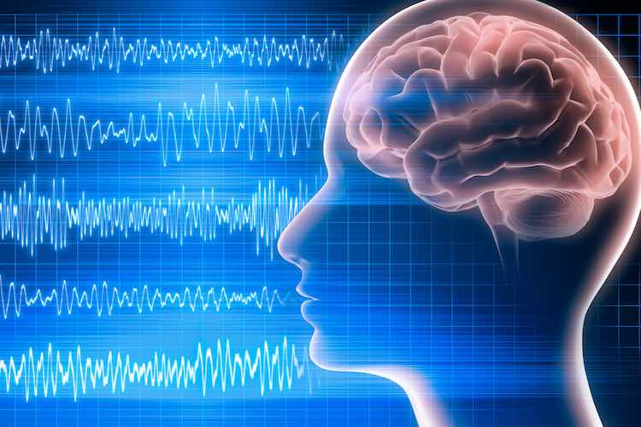
Bio-Signal Processing and Analysis

Slide 2
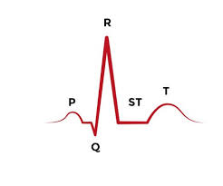
ECG: Electrocardiogram
An electrocardiogram (ECG) is one of the simplest and fastest tests used to evaluate the heart.
Electrodes (small, plastic patches that stick to the skin) are placed at certain spots on the chest, arms, and legs.
The electrodes are connected to an ECG machine by lead wires.
The electrical activity of the heart is then measured, interpreted, and printed out.
No electricity is sent into the body.
Natural electrical impulses coordinate contractions of the different parts of the heart to keep blood flowing the way it should.
An ECG records these impulses to show how fast the heart is beating, the rhythm of the heart beats (steady or irregular), and the strength and timing of the electrical impulses as they move through the different parts of the heart.
Changes in an ECG can be a sign of many heart-related conditions.
The standard ECG is referred to as 12-lead ECG since it includes 12 leads - using 10 electrodes.
Chest leads are also known as Precordial leads.

Slide 3
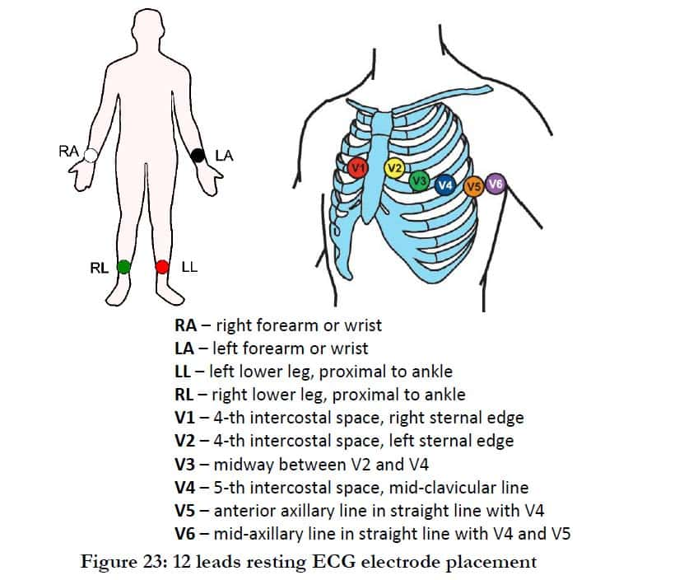
Placement of Electrodes:
Placement of chest (precordial) electrodes:
V1: fourth intercostal space, to the right of the sternum.
V2: fourth intercostal space, to the left of the sternum.
V3: placed diagonally between V2 and V4.
V4: between ribs 5 and 6 in the midclavicular line.
V5: placed on the same level as V4, but in the anterior axillary line.
V6: placed on the same level as V4 and V5, but in the midaxillary line.

Slide 4
ECG Analysis:
Based on the variations of the peaks the various pathological conditions are diagnosed.
https://www.ncbi.nlm.nih.gov/books/NBK2214/

Slide 5
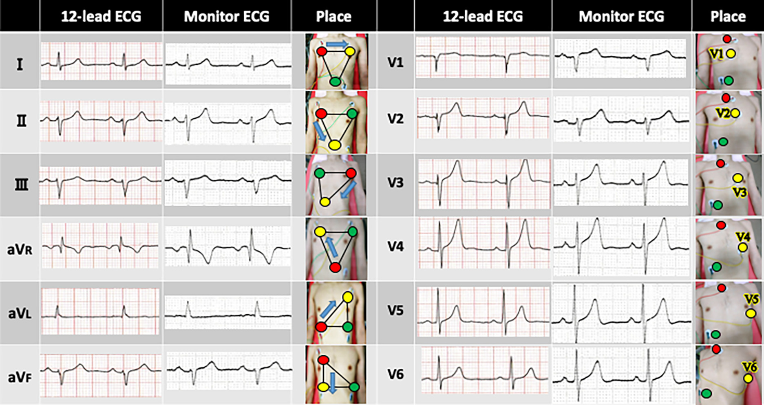

Slide 6
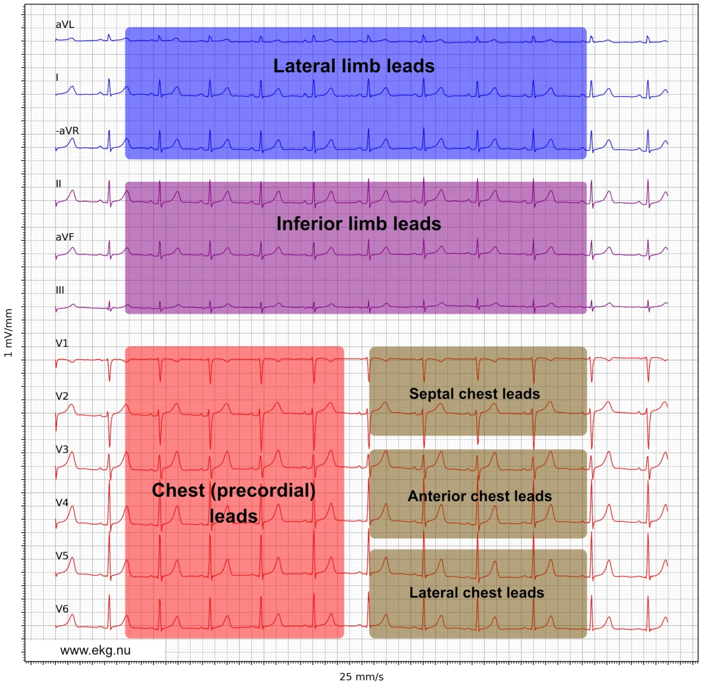

Slide 7
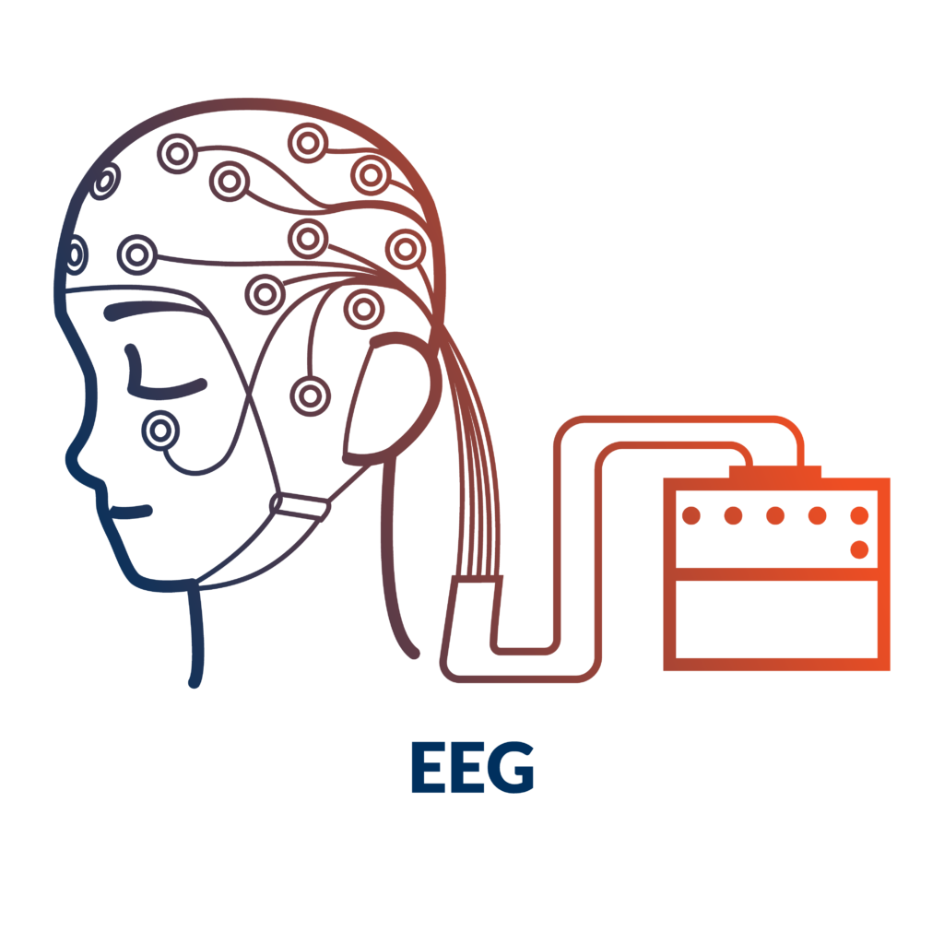
EEG: Electroencephalogram
An EEG is a test that detects abnormalities in your brain waves, or in the electrical activity of your brain.
During the procedure, electrodes consisting of small metal discs with thin wires are pasted onto your scalp.
The electrodes detect tiny electrical charges that result from the activity of your brain cells.
The charges are amplified and appear as a graph on a computer screen, or as a recording that may be printed out on paper.
Your healthcare provider then interprets the reading.

Slide 8
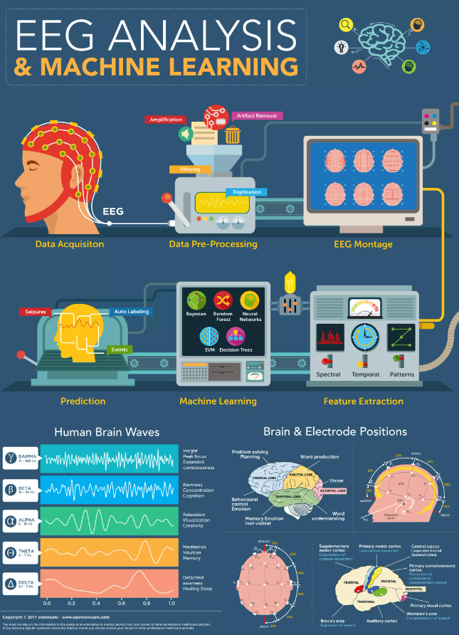
EEG Analysis:
There are 5 methods of analysis:
Frequency Domain Methods
Time Domain Methods
Time-Frequency Domain Methods
Non-Linear Methods
ANN Methods

Slide 9
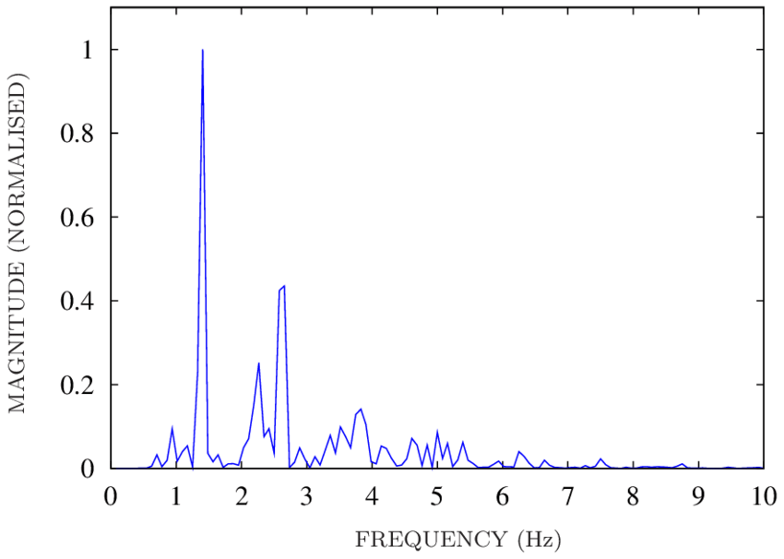
Frequency Domain Method:
Frequency domain analysis, also known as spectral analysis, is the most conventional yet one of the most powerful and standard methods for EEG analysis.
It gives insight into information contained in the frequency domain of EEG waveforms by adopting statistical and Fourier Transform methods.
Among all the spectral methods, power spectral analysis is the most commonly used, since the power spectrum reflects the 'frequency content' of the signal or the distribution of signal power over frequency.

Slide 10
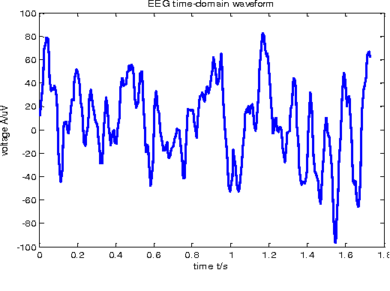
Time Domain Method:
There are two important methods for time domain EEG analysis: Linear Prediction and Component Analysis.
Generally, Linear Prediction gives the estimated value equal to a linear combination of the past output value with the present and past input value.
And Component Analysis is an unsupervised method in which the data set is mapped to a feature set.
Notably, the parameters in time domain methods are entirely based on time, but they can also be extracted from statistical moments of the power spectrum.
As a result, time domain method builds a bridge between physical time interpretation and conventional spectral analysis.
Besides, time domain methods offer a way to on-line measurement of basic signal properties by means of a time-based calculation, which requires less complex equipment compared to conventional frequency analysis.

Slide 11
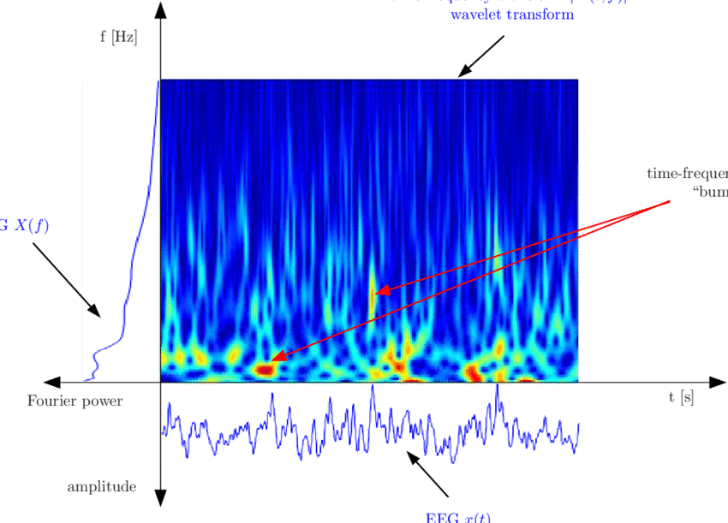
Time-Frequency Domain Method:
Wavelet Transform, a typical time-frequency domain method, can extract and represent properties from transient biological signals.
Specifically, through wavelet decomposition of the EEG records, transient features can be accurately captured and localized in both time and frequency context.
Thus Wavelet transform is like a mathematical microscope that can analyze different scales of neural rhythms and investigate small-scale oscillations of the brain signals while ignoring the contribution of other scales.
Apart from Wavelet Transform, there is another prominent time-frequency method called Hilbert-Huang Transform, which can decompose EEG signals into a set of oscillatory components called Intrinsic Mode Function (IMF) in order to capture instantaneous frequency data.

Slide 12
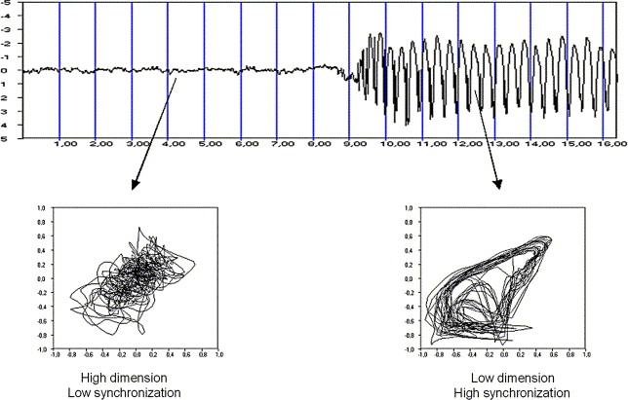
Non-Linear Method:
Many phenomena in nature are nonlinear and non-stationary, and so are EEG signals.
This attribute adds more complexity to the interpretation of EEG signals, rendering linear methods (methods mentioned above) limited.
Since 1985 when two pioneers in nonlinear EEG analysis, Rapp and Bobloyantz, published their first results, the theory of nonlinear dynamic systems, also called ‘chaos theory’, has been broadly applied to the field of EEG analysis.
To conduct nonlinear EEG analysis, researchers have adopted many useful nonlinear parameters such as Lyapunov Exponent, Correlation Dimension, and entropies like Approximate Entropy and Sample Entropy.

Slide 13
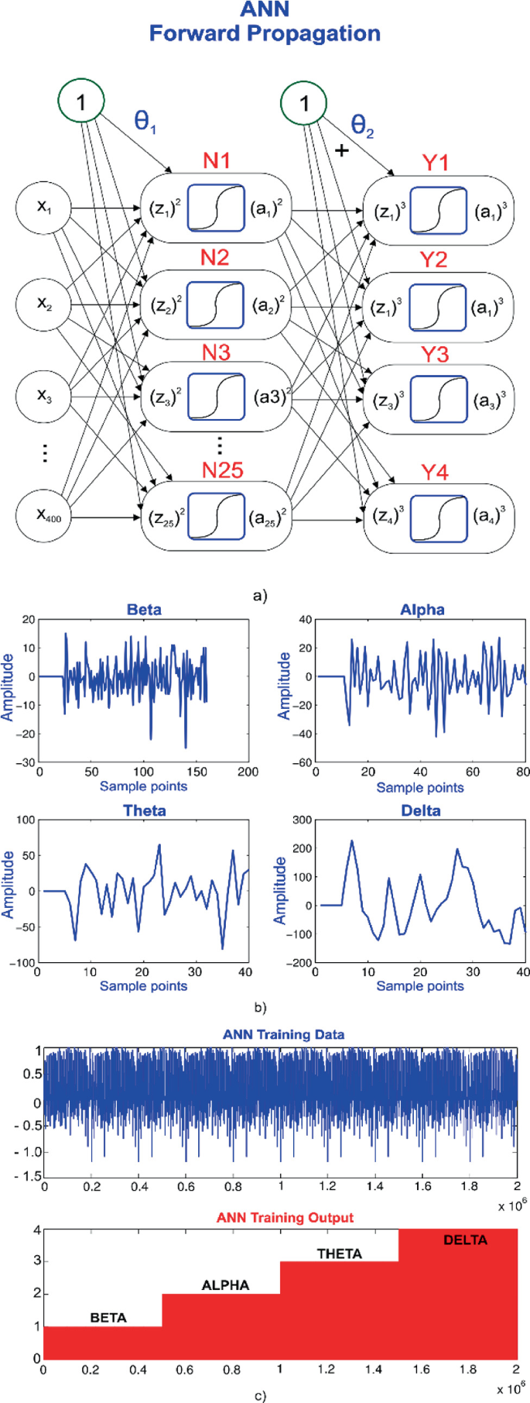
ANN Method:
The implementation of Artificial Neural Networks (ANN) is presented for classification of EEG signals.
In most cases, EEG data involves a preprocess of wavelet transform before putting into the neural networks.
RNN (Recurrent Neural Networks) was once considerably applied in studies of ANN implementations in EEG analysis.
Until the boom of deep learning and CNN (Convolutional Neural Networks), CNN method becomes a new favorite in recent studies of EEG analysis employing deep learning.
With cropped training for the deep CNN to reach competitive accuracies on the dataset, deep CNN has presented a superior decoding performance.
Moreover, the big EEG data, as the input of ANN, calls for the need for safe storage and high computational resources for real-time processing.
To address these challenges, a cloud-based deep learning has been proposed and presented for real-time analysis of big EEG data.

Slide 14
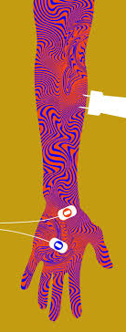
EMG: Electromyogram
Electromyography (EMG) measures muscle response or electrical activity in response to a nerve’s stimulation of the muscle.
The test is used to help detect neuromuscular abnormalities.
During the test, one or more small needles (also called electrodes) are inserted through the skin into the muscle.
The electrical activity picked up by the electrodes is then displayed on an oscilloscope (a monitor that displays electrical activity in the form of waves).
An audio-amplifier is used so the activity can be heard.
EMG measures the electrical activity of the muscle during rest, slight contraction and forceful contraction.
Muscle tissue does not normally produce electrical signals during rest.
When an electrode is inserted, a brief period of activity can be seen on the oscilloscope, but after that, no signal should be present.

Slide 15
EMG: Electromyogram
Continued…
After an electrode has been inserted, you may be asked to contract the muscle, for example, by lifting or bending your leg.
The action potential (size and shape of the wave) that this creates on the oscilloscope provides information about the ability of the muscle to respond when the nerves are stimulated.
As the muscle is contracted more forcefully, more and more muscle fibers are activated, producing action potentials.
A related procedure that may be performed is nerve conduction study (NCS).
NCS is a measurement of the amount and speed of conduction of an electrical impulse through a nerve.
NCS can determine nerve damage and destruction, and is often performed at the same time as EMG.
Both procedures help to detect the presence, location, and extent of diseases that damage the nerves and muscles.

Slide 16
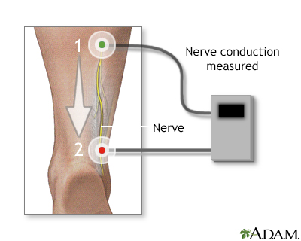
NCV: Nerve Conduction Velocity
A nerve conduction velocity (NCV) test — also called a nerve conduction study (NCS) — measures how fast an electrical impulse moves through your nerve.
NCV can identify nerve damage.
During the test, your nerve is stimulated, usually with electrode patches attached to your skin.
Two electrodes are placed on the skin over your nerve.
One electrode stimulates your nerve with a very mild electrical impulse.
The other electrode records it.
The resulting electrical activity is recorded by another electrode. This is repeated for each nerve being tested.
The speed is then calculated by measuring the distance between electrodes and the time it takes for electrical impulses to travel between electrodes.

Slide 17
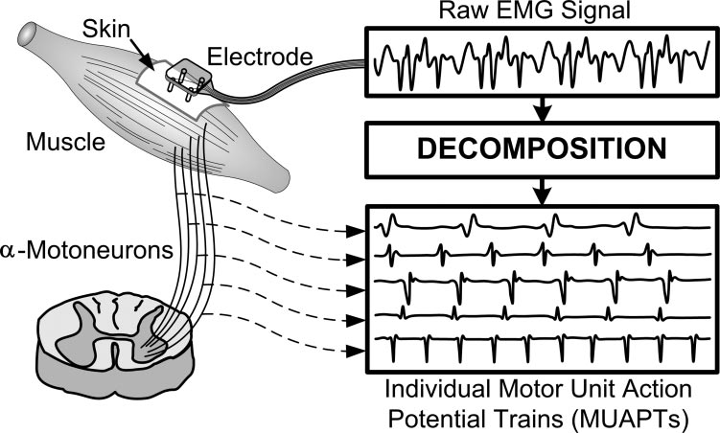
EMG Signal Decomposition:
EMG signals are essentially made up of superimposed motor unit action potentials (MUAPs) from several motor units.
For a thorough analysis, the measured EMG signals can be decomposed into their constituent MUAPs. MUAPs from different motor units tend to have different characteristic shapes, while MUAPs recorded by the same electrode from the same motor unit are typically similar.
Notably MUAP size and shape depend on where the electrode is located with respect to the fibers and so can appear to be different if the electrode moves position.
EMG decomposition is non-trivial, although many methods have been proposed.

Slide 18
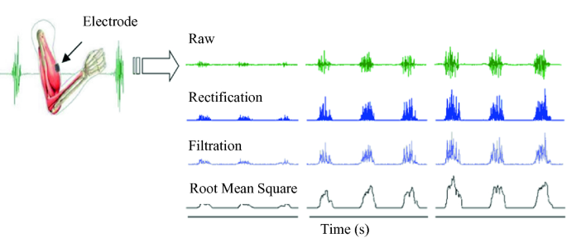
EMG Signal Processing:
Rectification is the translation of the raw EMG signal to a signal with a single polarity, usually positive.
The purpose of rectifying the signal is to ensure the signal does not average to zero, due to the raw EMG signal having positive and negative components.
Two types of rectification are used:
full-wave rectification and
half-wave rectification.
Full-wave rectification adds the EMG signal below the baseline to the signal above the baseline to make a conditioned signal that is all positive.
If the baseline is zero, this is equivalent to taking the absolute value of the signal.
This is the preferred method of rectification because it conserves all of the signal energy for analysis. Half-wave rectification discards the portion of the EMG signal that is below the baseline.
In doing so, the average of the data is no longer zero therefore it can be used in statistical analyses.

